Slide 1
Weekly meeting 18
Shengya Guo, CR/AVS3, 08.11.2024

Slide 2
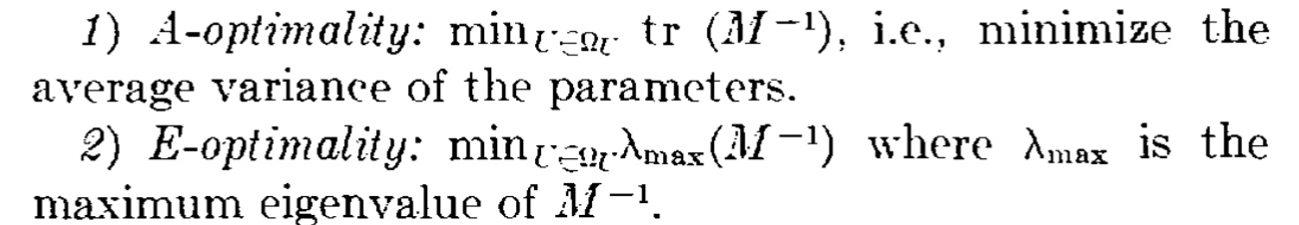
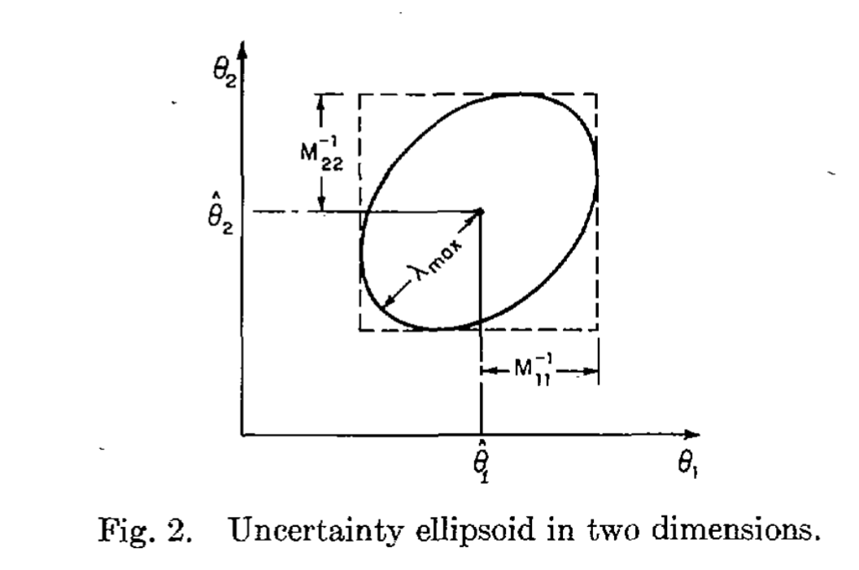
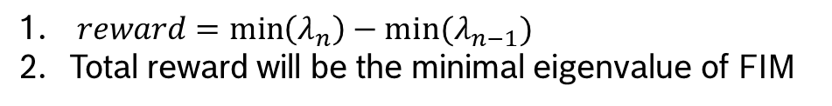
Reward function: E-optimality
Two Parameters Excitation
$reward=\min\left(λ_{n}\right)−min⁡(λ_{n−1})$
Total reward will be the minimal eigenvalue of FIM

Slide 3
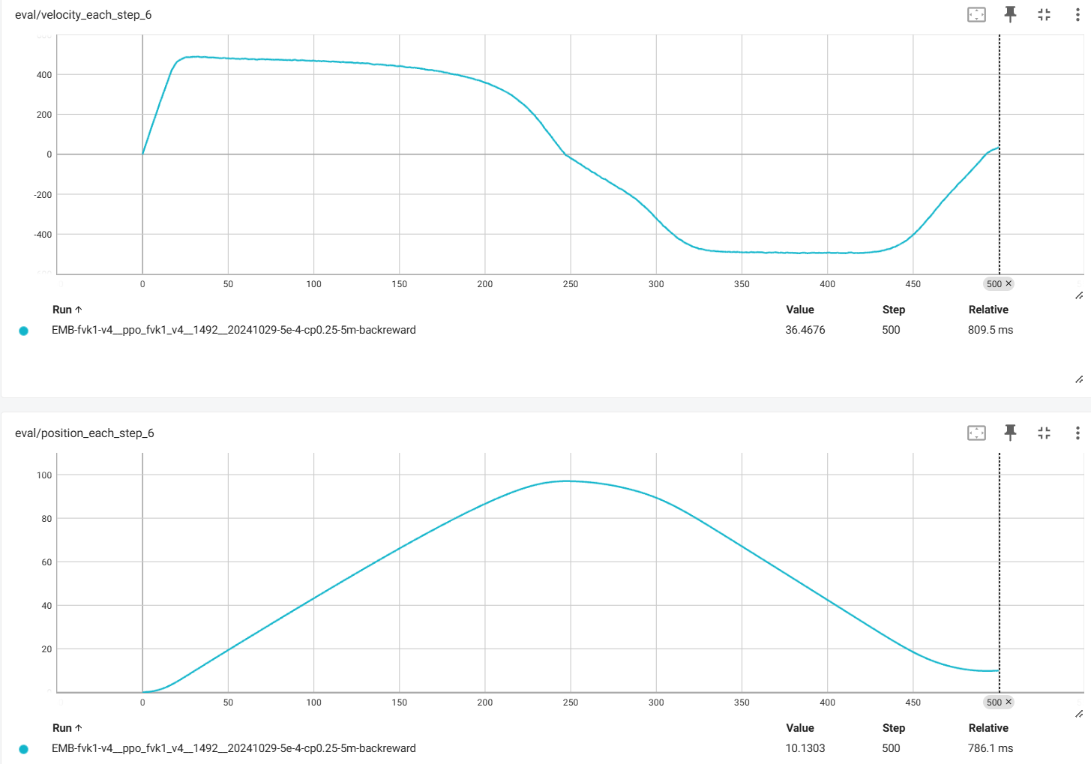
E-optimality: Result
Two Parameters Excitation
Before 300ms: Maximal step reward After 300ms: Minimal the difference with the trajectory
To achieve higher information content, both high position and high velocity are needed simultaneously.

Slide 4
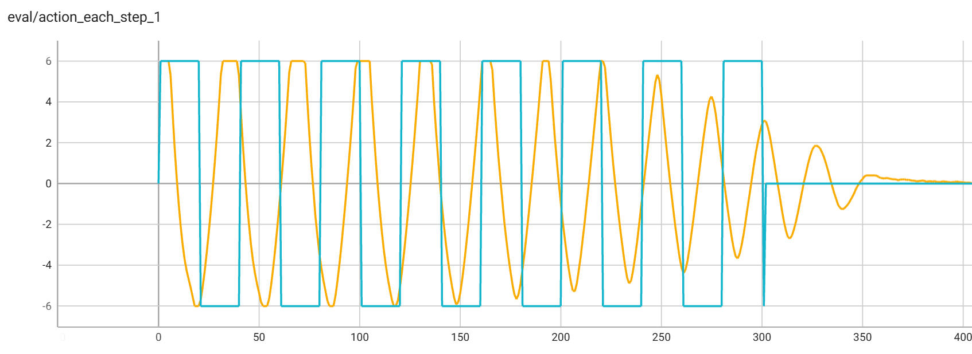
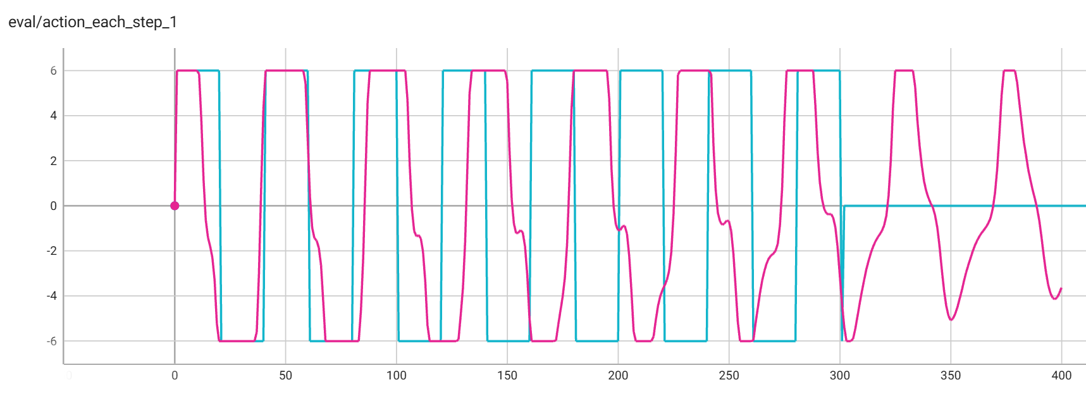
Review: D-optimality
Two Parameters Excitation

Slide 5
Comparison
Two Parameters Excitation
After training is complete, a unified testing reward function is used, calculating only the step rewards within 500 ms.

